Slide 1
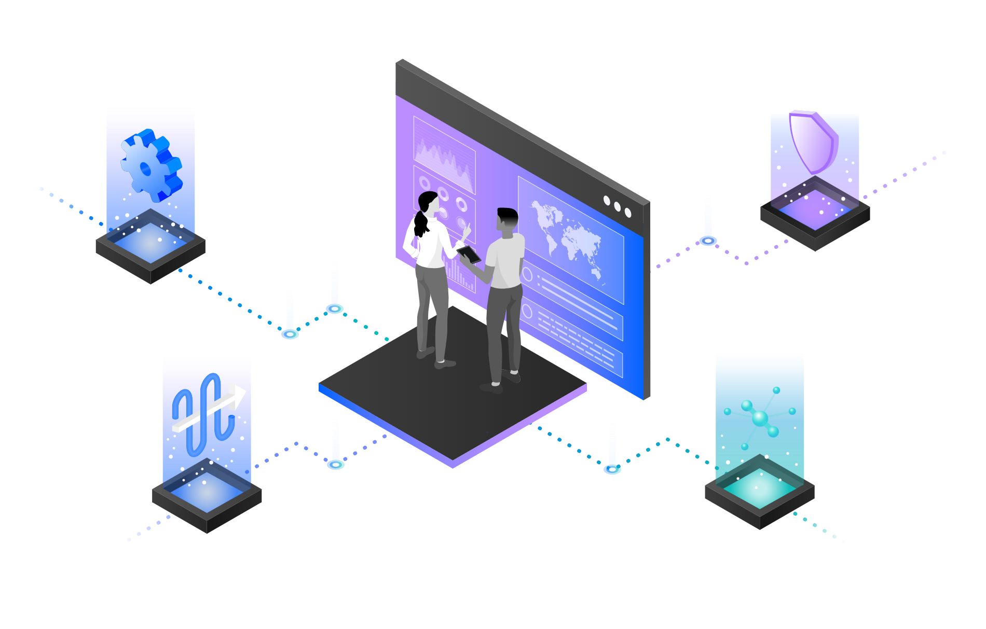
IBM Aspera
Fast File Transfer using Aspera on Cloud Demo
—
Cathy Daly – cdaly@us.ibm.com IBM Integration Enablement Leader
Rafael Osorio – rosorio@br.ibm.com IBM Integration Enablement Specialist
Notes:
Today we will demonstrate how Aspera on Cloud transfers, distributes and sync huge files and data sets, globally at maximum speed.

Slide 2

Finding a better big data transport solution!
Falling to move large files and massive sets of data quickly and reliably can limit and impact:
REDUCE COSTS
IMPROVED CUSTOMER
SERVICE
NEW OR
IMPROVED
BUSINESS
MODELS
BUSINESS IMPACT
DRIVE ADDITIONAL REVENUE
Notes:
Today, businesses across industries are facing greater challenges moving large files and massive sets of data quickly and reliably between global sites and teams. Failing to meet these challenges can limit an organization’s ability to meet critical business imperatives that yield increased revenues, reduced costs, improved customer service, and new or improved business models.

Slide 3

A better transfer technology – IBM Aspera FASP
With Aspera FASP technology:
Users can deliver live video and growing files;
Users can exchange files and data sets of any size—from many gigabytes to multiple terabytes and larger—quickly and reliably around the world;
The protocol integrates the latest security technologies, practices and auditing technologies to keep your data safe;
Notes:
This demo uses Aspera on Cloud to solve these issues with moving large files.
With Aspera FASP technology, users can deliver live video and growing files as well as exchange files and data sets of any size—from many gigabytes to multiple terabytes and larger—quickly and reliably around the world. In addition, the protocol integrates the latest security technologies, practices and auditing technologies to keep your data safe.

Slide 4
Demonstration Agenda
2
1
3
File Sharing
4
Accessing Aspera on Cloud
Working with Packages
Monitoring Activities
Notes:
This demo shows a typical file transfer scenario between different users in a company. Here you will see how to transfer, distribute and sync huge files and data sets, globally at maximum speed. You will learn how to accelerate collaboration with teams around the world on big data and large files. At the same time, you will see how to monitor and control data transfers. Let’s get started!

Slide 5
Demonstration
Notes:
See script documentation for assistance in demo execution

Slide 6
Demonstration Summary
In this demo we:
Accessed the Aspera on Cloud environment and explored the capabilities
Managed and shared files and folders;
Sent and downloaded packages;
Tracked usage and user activities;
From a business perspective we used Aspera on cloud to access and move data in a fast, secure and reusable way, by liberating data locked away in multiple file sharing systems. With Aspera, we are able to improve customer satisfaction through an easily access to data spread across multiple locations.
Notes:
Let’s summarize what we’ve done today.
In the demo we: accessed the Aspera on Cloud environment and explored the capabilities; managed and shared files and folders; send and download packages; track usage and user activities.
From a business perspective we used Aspera on cloud to access and move data in a fast, secure and reusable way, by liberating data locked away in multiple file sharing systems. With Aspera, we are able to improve customer satisfaction through an easily access to data spread across multiple locations.

Slide 7
Thank you
Cathy Daly – cdaly@us.ibm.com IBM Integration Enablement Leader —
Rafael Osorio – rosorio@br.ibm.com
IBM Integration Enablement Specialist
© Copyright IBM Corporation 2022. All rights reserved. The information contained in these materials is provided for informational purposes only and is provided AS IS without warranty of any kind, express or implied. Any statement of direction represents IBM’s current intent, is subject to change or withdrawal, and represent only goals and objectives. IBM, the IBM logo, ibm.com and IBM Automation are trademarks of IBM Corp., registered in many jurisdictions worldwide. Red Hat® and OpenShift® are trademarks or registered trademarks of Red Hat, Inc. or its subsidiaries in the United States and other countries. Other product and service names might be trademarks of IBM or other companies. A current list of IBM trademarks is available at Copyright and trademark information.
IBM Integration / © 2020 IBM Corporation
7
Notes:
Thank you!

Slide 8
8

Slide 9
Backup Slides

Slide 10


IBM Cloud Pak for Integration
Client & Partner Applications
Shared asset
repository
Unified governance framework
API management
Application integration
End-to-end security
Enterprise messaging
Event streaming
High speed data transfer
AI and machine learning
Robotic Process Automation
Natural language interactions
Process mining
Event detection
Machine learning
3rd Party integrations
Operational models
IBM Automation foundation
Robotic Process Automation
Natural language interactions
Process and task mining
Event detection
Machine learning
3rd Party integrations
Operational models
IBM Cloud
AWS
Microsoft Azure
Google Cloud
VMware
Private
IBM Z IBM LinuxOne IBM Power Systems
End points
IBM Integration / © 2021 IBM Corporation
10
Notes:
NOTE: Use this slide if you want to give a product overview and describe the capabilities presented in this demo.
IBM Cloud Pak for Integration is a hybrid integration platform with an automated, closed-loop approach that supports multiple styles of integration within a single, unified experience. This Demo demonstrates how Cloud Pak for Integration automates customer interactions using APIs and Integration. In this demo, you will see the API Management, Application Integration and End-to-end security capabilities in action.

Slide 11
Demonstration Scenario Car Repair Company
We are a Car Repair company: We take in vehicles with problems and repair them – seems simple but…
We want to gain business advantage by allowing multiple car leasing companies to use us to repair their cars – these companies insist that we expose APIs for them to call to do business with them.
We want to allow their customers to book their cars in for repair and get an estimate for price and number of days in real time – in seconds.
We want to allow them to send photos of their cars so we can check for type, damage etc.
We want to check for errors and issues up-front as quickly as possible to feed back to the customer in real time.
We want to minimize manual processes and have the repair request automatically create a repair case in our CRM system (Salesforce).
Notes:
NOTE: Use this slide if you want to give an overview about the Demo Scenario
This demo is about how to automate customer interactions. To implement this automation, we will use both APIs and integrations to back-end applications. The demo scenario is related to a car repair, but this is just an example. The same techniques are applicable to your environment in support of your customers.
In this demo:
We are a Car Repair company: We take in vehicles with problems and repair them – seems simple but…
We want to gain business advantage by allowing multiple car leasing companies to use us to repair their cars – these companies insist that we expose APIs for them.
We want to allow their customers to book their cars in for repair and get an estimate for price and number of days in real time.
We want to allow them to send photos of their cars so we can check for type, damage etc.
We want to check for errors and issues up-front as quickly as possible to feed back to the customer in real time.
We want to minimize manual processes and have the repair request automatically create a repair case in our CRM system (Salesforce).

